Slide 1
Drug Use Risk Analysis
Depression prediction based on drug use
Shaked Shalem

Slide 2

16.2 million adults
in the US have experienced a major depressive episode in the past year
According to Mental Health America
Notes:
After this sentence:
“Another interesting fact about depression…. “

Slide 3
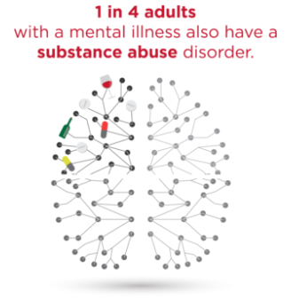
Motivation
“One in three adults
who abuse drugs or alcohol also experience depression.”
According to the Journal of Clinical Psychiatry
Notes:
20 seconds
Depression. More specifically for my project, I wanted to explore the relationship between drug use and depression.
One in three adults who abuse drugs or alcohol also experience depression.
The purpose of this project is to predict whether a person will experience depression in the last year based on his drug use
That fact lead me to my capstone project which is to predict depresiion based on drug use..

Slide 4
Data
National Survey on Drug Use and Health, 2012
60,000 samples
3,000 features
8% experienced depression
Notes:
30 seconds
I used the National Survey on Drug Use and Health, 2012 as my data set. This is a huge data set with about 60000 responders and about 3000 columns. They really asked people about any aspects about their life. Questions about any drug that you can think of, mental health and demopgaphic information. They also gave them 30$ and promised anonymity which inclined people to answer these sensitive questions.
Make the numbers more visual

Slide 5
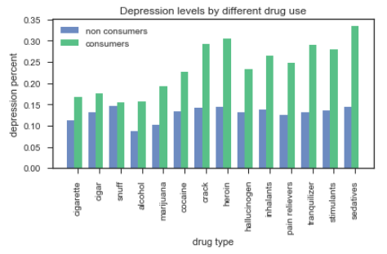
Feature Engineering
Notes:
20 seconds
Explain one feature
Initial findings

Slide 6
Models
Random Forest
Gradient Boosting
Notes:
30 seconds
The next step was to choose models. I started with RF because:
Imbalanced data.
Reduction in overfitting: by averaging several trees, there is a significantly lower risk of overfitting.
I also tried GB because
Combination of weak learners
Each new tree helps to correct errors made by previously trained tree.
Non linear relationship

Slide 7
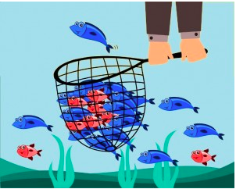
Recall - Precision Trade Off
Notes:
30 seconds
The most important issue for me was to not miss people who have depression, even at a price of being overly concerned with people who do not have depression.
I wanted to catch the all of the red fish, even if some blue fish come along.
In terms of performance, I wanted to focus on the recall rate of the model. It was more important to me to correctly identify people with depression than mistakenly label non depressed sample as depressed.
Add numbers
The precision is intuitively the ability of the classifier not to label as positive a sample that is negative.
The recall is intuitively the ability of the classifier to find all the positive samples.

Slide 8
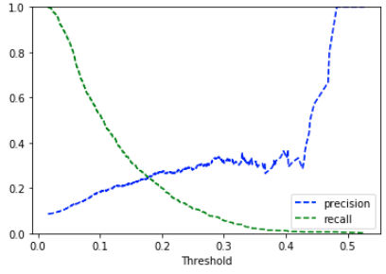
Optimal Recall - Precision Trade Off
90% Recall 10% Precision
Notes:
30 seconds
Looking at one of the model’s recall precision graph, I chose the optimal trade off point to be 90% recall and 10% precision

Slide 9
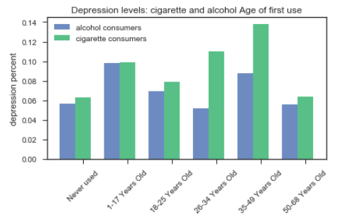
Feature Importance
Notes:
30 seconds
These are the most important features in my model.
Fix the never used alcohol to alc and cig. Move the never used to the start.

Slide 10
Thanks!
Any questions?

Slide 11
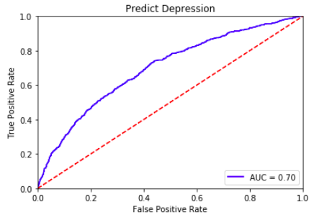
Performance
Notes:
20 seconds

